Slide 1

Water resources: Use and overutilization of surface and ground water
Dr. Vinayak V. Pathak
Department of Chemistry

Slide 2
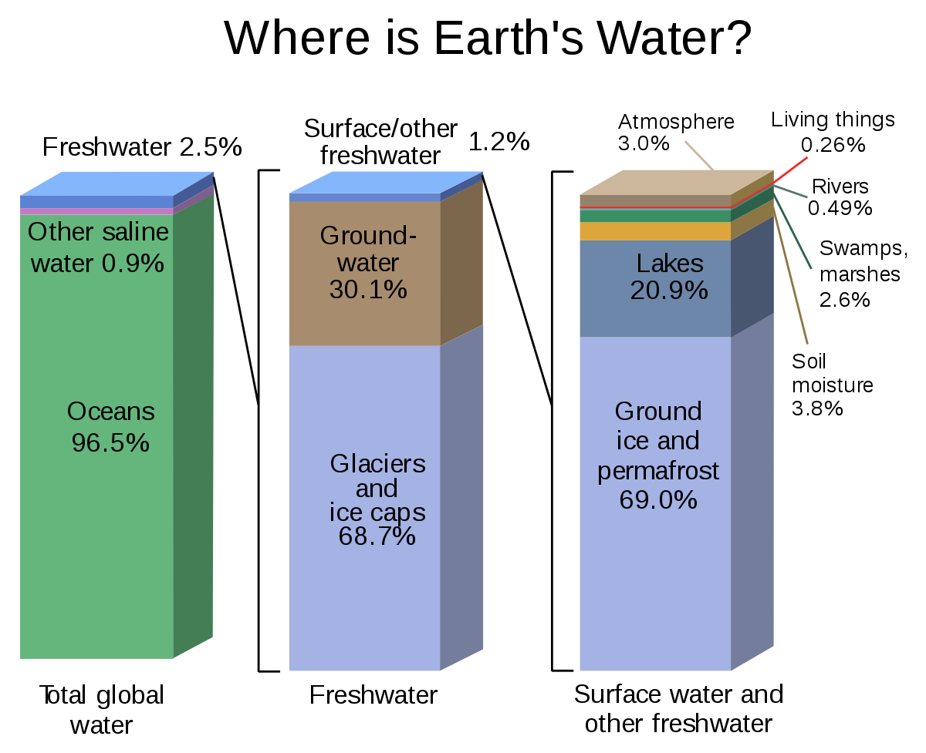

Slide 3
Water Resource: India
It involves water from precipitation, ground water and surface water.
Annually India receives about 1170 mm of precipitation, which is considered as a source of fresh water.
With 18% of global population, India has only 4% of world’s water resource.
80% of its area experiences rains of 750 mm or more a year but this rainfall is not uniform in time or geography.
Despite extensive river system, safe clean drinking water as well as irrigation water supplies for sustainable agriculture are in shortage across India.

Slide 4
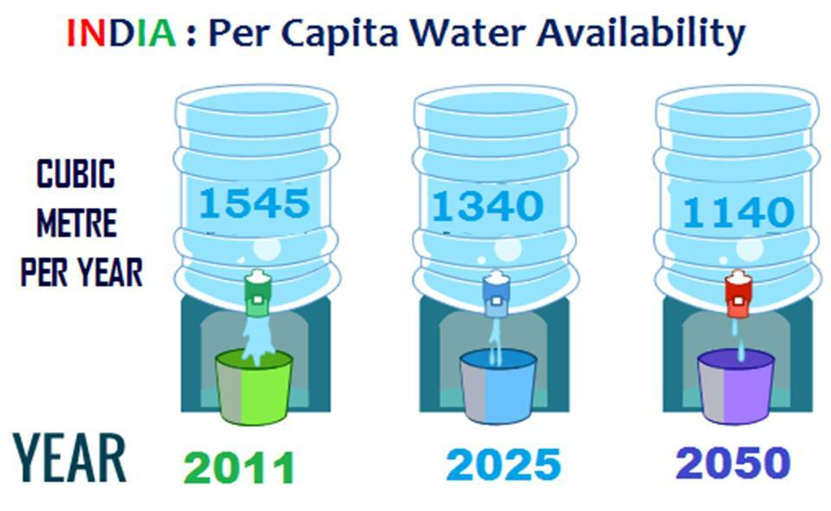
Vast area of India is under tropical climate which is conducive throughout the year for agriculture.
Though the total water resources are adequate to meet all the requirement of country , water supply gap due to temporal and spatial distribution of water resources are to be bridged by interlinking the rivers of India.

Slide 5
India water facts
The rivers have been the heart and soul of India’s growth as well as culture.
12 rivers are classified as major river which covers the total catchment area of 253 mha.
The Ganga-Brahmaputra-Meghna system is the largest river system in India with 43% of the catchment area of the all major river systems.
46 rivers are classified as medium river that cover catchment area of 24.6 mha.
Other inland water sources involve water reservoir such as lakes, ponds, oxbow, beels and brackish water, which cover an area of 7mha.

Slide 6
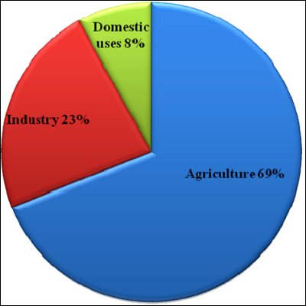

Slide 7
Status of ground water
Groundwater is a replenish able source.
Annual consumption of groundwater in India is about 433 bcm.
Main source of ground water is recharge from monsoon/ precipitation.
Other sources of recharge involves seepage from canals, tanks, ponds and other water structures and irrigation.
Among all states, Uttar Pradesh has highest net ground water availability.

Slide 8
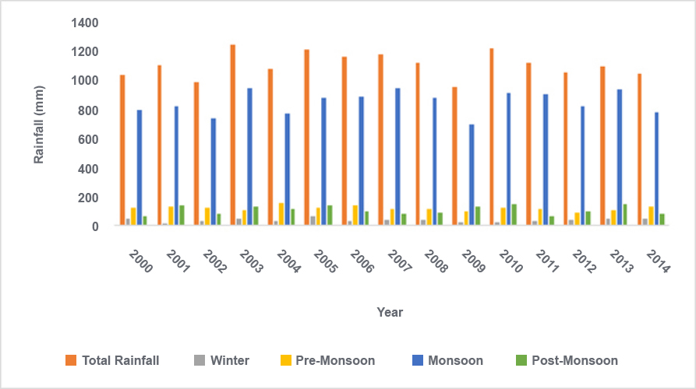

Slide 9
Overexploitation of water
India is the biggest user of ground water. It extracts more ground water than China and US.
In 2015, the standing committee on water resources found that groundwater forms the largest share of India’s agriculture and drinking water supply.
About 89 per cent of groundwater extracted in India is used for irrigation making it the highest category user in the country. Household use comes second with 9 per cent share of the extracted groundwater followed by industry that uses only two per cent of it.
Overall, 50 per cent of urban water requirement and 85 per cent of rural domestic water need are fulfilled by groundwater.
This kind of use has caused a reduction in groundwater levels in India by 61 per cent between 2007 and 2017, according to report by Central Ground Water Board (CGWB), presented in the Lok Sabha last year.

Slide 10
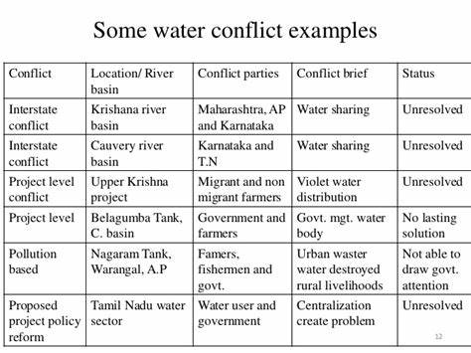
Water conflicts
The term ‘water conflict’ is used to explain the conflicts between countries, states, groups, over the right to access the water resources.

Slide 11
Watershed management
The term watershed refers to a region of common drainage outlet of all flowing water inside one place.
In watershed management, rain fed areas are conserved or upgraded with other natural facilities such as land, water, plant, animal and human resource.
Watershed management prevent surface water runoff and improves the soil moisture content.
Watershed management also determines the opportuities to reduce the water pollution.

Slide 12
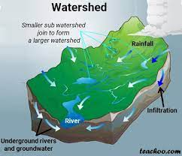

Slide 13
Rain water harvesting
Rainwater harvesting is the simple process or technology used to conserve Rainwater by collecting, storing, conveying and purifying of Rainwater that runs off from rooftops, parks, roads, open grounds, etc. for later use.
Rainwater harvesting systems consists of the following components:
Catchment- Used to collect and store the captured Rainwater.
Conveyance system – It is used to transport the harvested water from the catchment to the recharge zone.
Flush- It is used to flush out the first spell of rain.
Filter – Used for filtering the collected Rainwater and remove pollutants.
Tanks and the recharge structures: Used to store the filtered water which is ready to use.

